Slide 1
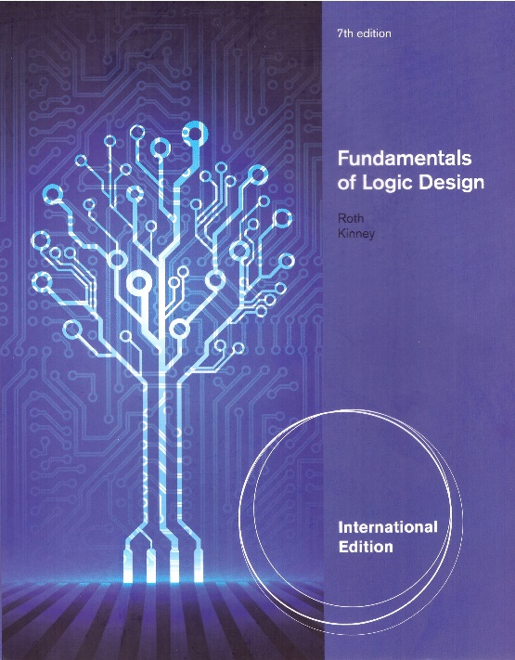
Unit 1
INTRODUCTION NUMBER SYSTEMS AND CONVERSION
This chapter in the book includes:
Objectives
Study Guide
1.1 Digital Systems and Switching Circuits
1.2 Number Systems and Conversion
1.3 Binary Arithmetic
1.4 Representation of Negative Numbers
1.5 Binary Codes

Slide 2
Chapter Objectives
Topics introduced in this chapter:
Difference between Analog and Digital System
Difference between Combinational and Sequential Circuits
Binary number and digital systems
Number systems and Conversion
Add, Subtract, Multiply, Divide for Positive Binary Numbers
1’s Complement, 2’s Complement for Negative binary number
BCD code, 6-3-1-1 code, excess-3 code

Slide 3
1.1 Digital Systems and Switching Circuits
Digital systems are used extensively in computation, data processing, control, communication, and measurement
- Reliability, Integration, …
Analog – Continuous, uncountable
- Natural Phenomena
(Pressure, Temperature, Speed…)
- Difficulty in realizing, processing using electronics
Digital – Discrete, countable
- Binary Digit ➔ Signal Processing as Bit unit
- Easy in realizing, processing using electronics
- High performance due to Integrated Circuit Technology

Slide 4
Design of Digital Systems
Three design levels: system design, logic design, circuit design
high-level low-level
System design
Breaking the overall system into subsystems
Specifying the characteristics of each subsystems
System design of a digital computer system
specifying the number and type of memory units, arithmetic units, and I/O devices
Specifying the interconnection and control of these subsystems.

Slide 5
Design of Digital Systems
Logic design
Determining how to interconnect basic logic blocks to perform a specific function
An example is determining the interconnection of logic gates and flip-flops required to perform binary addition
Circuit design
Specifying the interconnection of specific components such as resistors, diodes, and transistors to form a gate, flip-flops, or other logic blocks.
Most contemporary circuit design is done in integrated form.
This book is largely devoted to a study of logic design!

Slide 6
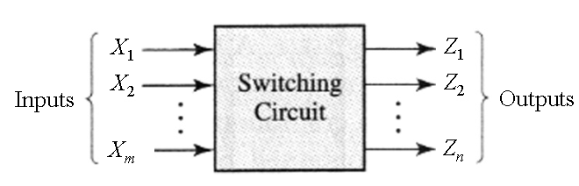
Switching Circuit
Combinational Circuit :
- outputs depend on only present inputs, not on past inputs
Sequential Circuit:
- outputs depend on both present inputs and past inputs
- have “memory” function

Slide 7
Binary Digit?
Binary:- Two values(0, 1)
- Each digit is called as a “bit”
Good things in Binary Number
- Number representation with only two values (0,1)
- Can be implemented with simple electronics devices
(ex: Voltage High(1), Low(0)
Switch On (1) Off(0)…)

Slide 8
1.2 Number Systems and Conversion
Radix (Base)
Decimal
Binary
Octal
Hexadecimal

Slide 9
1.2 Number Systems and Conversion
Conversion of Decimal to Base-R

Slide 10
1.2 Number Systems and Conversion
Example: Decimal to Binary Conversion
2
53
2
26
rem. = 1 = a₀
2
13
rem. = 0 = a₁
2
6
rem. = 1 = a₂
2
3
rem. = 0 = a₃
2
1
rem. = 1 = a₄
0
rem. = 1 = a₅

Slide 11
1.2 Number Systems and Conversion
Conversion of a decimal fraction to Base-R
Example:

Slide 12
1.2 Number Systems and Conversion
Example: Convert 0.7 to binary
Process starts repeating here because .4 was previously
obtained

Slide 13
1.2 Number Systems and Conversion
Example: Convert 231.3₄ to base-7
7
45
7
6
rem.3
0
rem.6

Slide 14
1.2 Number Systems and Conversion
Example: Conversion of Binary to Octal or Hexa-decimal
1001101.010111 ₂ = 01001101.01011100 ₂ = 4D.5C ₁₆
(101011010111 )₂ = ( )₈, octal
(10111011)₂ = ( ) ₈, octal
(1010111100100101)₂ = ( ) ₁₆, hexadecimal
(1101101000)2 = ( ) ₁₆, hexadecimal

Slide 15
1.3 Binary Arithmetic
Addition
and carry 1 to the next column
Example:
carries

Slide 16
1.3 Binary Arithmetic
Subtraction Example with Decimal
column 2
column 1
note borrow from column 1
note borrow from column 2

Slide 17
1.3 Binary Arithmetic
Subtraction
and borrow 1 from the next column
Example
(indicates
a borrow
From the
3rd column)
borrows
borrows

Slide 18
1.3 Binary Arithmetic
Multiplication
Multiply: 13 x11(10)
multiplicand
multiplier
first partial product
second partial product
sum of first two partial products
third partial product
sum after adding third partial product
fourth partial product
final product (sum after adding fourth partial product)

Slide 19
1.3 Binary Arithmetic
Division
The quotient is 1101 with a remainder of 10.

Slide 20
1.4 Representation of Negative Numbers
Several representations of negative binary numbers are possible
The sign and magnitude number system
The 2’s complement number system (most popular)
The 1’s complement number system

Slide 21
1.4 Representation of Negative Numbers
b
n
–
1
b
1
b
0
Magnitude
MSB
(a) Unsigned number
b
n
–
1
b
n
–
2
b
1
b
0
Sign
Magnitude
0 denotes +
1 denote -
MSB
(b) Signed number

Slide 22
1.4 Representation of Negative Numbers
2’s complement representation for Negative Numbers
Example:
1’s complement representation for Negative Numbers
Example:
2’s complement: 1’s complement + ‘1’

Slide 23
1.4 Representation of Negative Numbers
+N
Positive
integers
(all systems)
-N
Negative integers
Sign and
magnitude
2’s complement N*
1’s complement
N
+0
+1
+2
+3
+4
+5
+6
+7
0000
0001
0010
0011
0100
0101
0110
0111
-0
-1
-2
-3
-4
-5
-6
-7
-8
1000
1001
1010
1011
1100
1101
1110
1111
-
-
1111
1110
1101
1100
1011
1010
1001
1000
1111
1110
1101
1100
1011
1010
1001
1000
-

Slide 24
1.4 Representation of Negative Numbers
2’s complement representation for N = 5
00000
00001
Single zero
11111
11110
−1
0
00010
1
11101
−2
2
11100
−3
−4
.
.
.
.
.
.
−15
−16
15
10001
10000
01111

Slide 25
1.4 Representation of Negative Number
Addition of 2’s complement Numbers
Case 1
(correct answer)
Case 2
wrong answer because of overflow
(+11 requires 5 bits including sign)
Case 3
(correct answer)

Slide 26
1.4 Representation of Negative Numbers
Addition of 2’s complement Numbers
Case 4
correct answer when the carry from the sign bit
is ignored (this is not an overflow)
Case 5
correct answer when the last carry is ignored
(this is not an overflow)
Case 6
wrong answer because of overflow
(-11 requires 5 bits including sign)

Slide 27
1.4 Representation of Negative Numbers
Addition of 1’s complement Numbers
Case 3
(correct answer)
Case 4
(end-around carry)
(correct answer, no overflow)
Case 5
(end-around carry)
(correct answer, no overflow)

Slide 28
1.4 Representation of Negative Numbers
Addition of 1’s complement Numbers
Case 6
(end-around carry)
(wrong answer because of overflow)

Slide 29
1.4 Representation of Negative Numbers
Addition of 1’s complement Numbers
11110100
11101011
(
1
)
11011111
1
(feed back end-around carry)
11100000
=
31
Addition of 2’s complement Numbers
(discard end-around carry)

Slide 30
1.5 Binary Codes
Decimal | Gray code
0 | 0000
1 | 0001
2 | 0011
3 | 0010
4 | 0110
5 | 1110
6 | 1010
7 | 1011
8 | 1001
9 | 1000
Decimal Digit | 8-4-2-1 Code (BCD) | 6-3-1-1 Code | Excees-3 Code | 2-out-of-5 Code | Gray Code
0 1 2 3 4 5 6 7 8 9 | 0000 0001 0010 0011 0100 0101 0110 0111 1000 1001 | 0000 0001 0011 0100 0101 0111 1000 1001 1011 1100 | 0011 0100 0101 0110 0111 1000 1001 1010 1011 1100 | 00011 00101 00110 01001 01010 01100 10001 10010 10100 11000 | 0000 0001 0011 0010 0110 1110 1010 1011 1001 1000

Slide 31

1.5 Binary Codes
6-3-1-1 Code
ASCII (American Standard Code for Information Interchange)
refer Table 1-3
S t e v e
1010011 1110100 1100101 1110110 1100101
Try your Korean name. (i.e. 유재석)

